Slide 1
Self-Knowledge and Its Influences On Other Knowledge
Herbert Klitzner
New York Academy of Sciences
May 16, 2013

Slide 2
Self-Knowledge Benchmarks
Know Thyself – Socrates
The Unconscious and the Conscious -- Freud

Slide 3
Further Writers
These writers urge dealing with yourself and your life in a realistic way rather than a self-deluding, heroic, or romanticized way:
Voltaire (Candide)
Byron Katie (The Work)
George Bernard Shaw (Arms and the Man/Chocolate Soldier)
L. Frank Baum (The Wizard of Oz)
Rumi (Caravan poem)

Slide 4
Sections of My Talk –
DAMASIO and Elemental Knowledge
(Most of the Talk)
Locating the Self in a Social Mental Rotation Task in a Child Development Study
PERSONAL SCIENCE – Speculations on an emerging Science of the Self, performed by the Self, using an Ecological Individual Differences Approach, and Market Implications (“Know Thyself” plus “consumer apps”) .

Slide 5
Antonio Damasio
Summary of Section / Keywords
Introduction -- Self and Consciousness
Three Stages of Self (analogous to reptile, mammalian, and human brain)
Triad Structure for Elementary Knowledge Elements (Image Level)
Brain Access of Elementary Internal and External Information (Roles of the Cortex and Brain Stem)
Thalamus is the Mediator between the Cortex (external object information) and the Brain Stem (internal status)

Slide 6
Three Stages of Self (Damasio)
(Refers To Stages of Processing)
Proto-Self
Core Self
(Consciousness requires a protagonist)
Autobiographical Self
(not fully a part of Damasio’s research)

Slide 7
Introduction – Self and Consciousness (Damasio)
New book (2012) – Self Comes To Mind: Constructing the Conscious Brain
  Constructed by theorists
  Constructed functionally/biologically like layers in a 3-D printer output process
Core Self – A Self, serving as a protagonist, is required to add to the lower mind, as a constituent, to achieve consciousness.
Proto-Self – Is a lower stage of processing. It uses mind processes built on images of internal states, including transient instantiations and non-conscious awareness of these.
These brain stem images are necessarily non-external-sensory because of their simplicity of form and content and limited access to the world.

Slide 8
Knowing
p. 167-169
Delivering Knowledge to the Mind
“The self-as-object can also operate as self-as-knower.”
This resonates with the architecture of a general computer system – that a program and data can be held in the same memory storage. Thus, the program can modify itself.
p. 168
Consciousness Depends on Self
“…the term consciousness does not refer simply to a plain mind process, without the self feature.”

Slide 9
Conscious Minds and Knowledge
p. 198-203
Triads of Knowledge Elements
“Conscious minds arise from establishing a relationship between an organism and the object-to-be-known.”

Slide 10
Mapping and Image
p. 68-69
Brain as Mapper
“The Brain is a born cartographer…”
…the cartography began with the mapping of the body in which the brain sits.”
“Throughout this book, I use the terms image, map, and neural pattern almost interchangeably.”
Anticipation (As-If-Body) Space – a copy of an action space, but not committed to follow-through -- furnishes readiness to act, as an anticipation space, but can be turned off – it cues up the anticipated response to execute for the situation. (p. 108-109, Mapping Body States and Simulating Body States)

Slide 11
Triad Structure for Elementary Knowledge Elements (Image Level)
OBJECT (Entity) – IMPACT – BODY STATE
External object image (from sensory tools);
image stored in Cortex.
Internal body status image.
Impact of object on body, stored as an image.

Slide 12
The Nature of Memory Records
Rather than making a record of an entity’s structure, the brain actually records the multiple consequences of the organism’s interactions with the entity.
What we memorize of our encounter with a given object is not just its visual structure as mapped in optical images of the retina.
The following are also needed – what is the body doing and what is happening to it – in other words, the sensorimotor patterns for:

Slide 13
Sensorimotor Patterns Associated With --
Eye and Neck, Whole-body movements
Touching and manipulating
Previously acquired memories pertinent to the object
Triggering of Emotions and Feelings relative to the object

Slide 14
Brain Access of Elementary
Internal and External Information
The Cortex cannot access current body state information directly (autonomic/internal functions – somatosensory, proprioceptive), but the Brain Stem can do this. This information can be described as a simple log of body actions and settings for various muscles and organs.
Information type: LOG.
The Brain Stem cannot access the complex image data on external stimuli, containing structural information of the object; but the Cortex can do this.
Information Type: STRUCTURE.
EACH SUB-ORGAN IS INITIALLY IGNORANT OF THE INFORMATION GENERATED BY THE OTHER, because of the location and format of the information in the brain.
But the Thalamus can access each from its source and generate or assemble the Triad Set of Images, and blend their results.

Slide 15
Thalamus is the Mediator
p. 265-267
Interdependency of Cortex and Brain Stem via Mediation of the Thalamus:
“Because of its mastery in the role of life regulator, the brain has long been the recipient and the local processor of the information needed to represent the body and control its life.”
“…the brain stem also developed the machinery required for elementary mind processes.”
On the other hand, the greater complexity of the cerebral cortex has enabled detailed image-making, expanded memory capacity, imagination, reasoning, and eventually language.”
“Objects exist as images only in the cerebral cortex and cannot be fully imaged in the brain stem.”
“…the thalamus is best described as the marriage broker of the oddest couple.” [Note: Nicholas Schiff, Director of the Laboratory for Cognition and Neuromodulation at Weill Cornell College of Medicine, stimulates the thalamus of patients who have been unconscious for long periods of time to awaken successfully.]

Slide 16
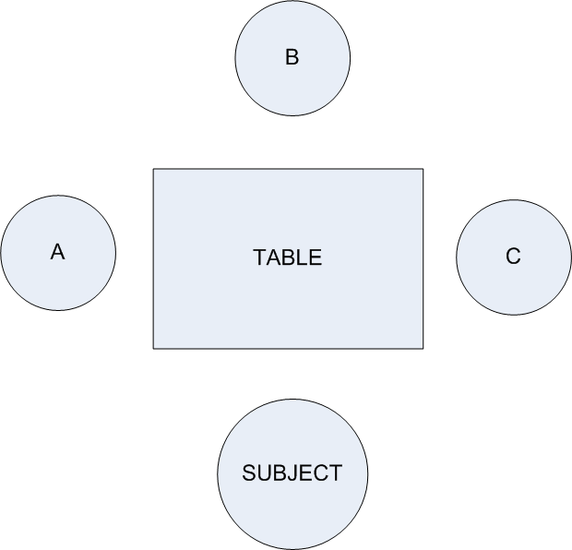
Mental Rotation Task – 4 Kids
Ask Subject, “What Does Kid C See”
(Who Is Left, Center, and Right?)

Slide 17
Mental Rotation and the Self
Research on Mental Rotation and the Location of Self
(Child Development – Teachers’ College, early 1970s)
Described to me by the professor supervising the research, during a conversation around 1973. Here is my reconstruction of it from memory. I have been unable to locate the research paper at this point, though I have tried.
The study examined short-term memory constraints at a specific age, 8, and the ability of children to perform a mental rotation of a specific social configuration – 4 kids seated around a square table – the task was to report what was the structure of what was seen by the kid to the right of the subject.
Computational modeling (Juan Pasqual-Leone) predicted that kids of this age should have sufficient STM (short-term memory) to do the mental rotation task
(3 slots, one for each object mentally rotated and placed).
In the experiment, the subjects failed. The researchers reasoned and basically concluded that the kids failed because they were obliged internally to use one of their 3 slots of short-term memory to track their own actual position, not just the position of themselves seen by the kid to their right. The researchers concluded that there was a Self-Integrity information need that overrided the given task.
This recollection demonstrates that researchers 40 years ago were active in studying the effects of self-knowledge on the application of developmental cognitive abilities, in this case mental rotation and short-term memory.

Slide 18
Levels of Self
Augmented by Personal Science
Scientific Knowledge of Self
Autobiographical Self
Core Self
Proto-Self

Slide 19
Personal Science - Background
I was a PC Market Forecaster from 1980-1985. My forecasts were accurate:
  Fast-accelerating sales volumes and falling prices
  Rapidly increasing performance – speed, capacity, complexity, ease of use
  Broad participation in the market by the various sectors of society (consumer, small business, major enterprise, education)
  Serious uses of the software
  Primacy of word processing applications for most users.
My Long-Range Observation (1982) -- The personal computer (and other personal technology to come) was slowly becoming a mirror for the user, reflecting and sometimes analyzing aspects of his/her processes and attributes – in health, writing, perception, goals and paths, consumer intents and history, etc.

Slide 20
Personal Science -- Concept
Personal attributes means much more than genetic information.
There is more to genes than medical uses.
  Craig Venter’s own genome was sequenced circa 2000 as part of the Human Genome Project.
  “The Gene” for Risk & Entrepreneurship was not present.
  But the Gene for Curiosity and Exploration was present.
  This gave Craig another way of looking at himself.

Slide 21
Personal Science
(System and Market Tools and a Scientific View of Self)
DNA /Affordable Personal Genome – Know Thy Genes?
What Is a support system for Personal Science?
  Researching: Investigating, probing hypotheses and relationships in the data; integrating findings between areas.
  Defining needs: Market-oriented needs/opportunities based on this investigation.
  Acquiring and testing needed goods and services.
    Internet Market Platform model to seek out tailored goods and services, such as in medicine and education, recreation and social development, parenting and retirement.
How will this support system affect self-image, self-knowledge, and other knowledge?
  We don’t know for sure, but there is great potential.
  I predict that this system will develop rapidly in scope once it is offered, and become as widely used as email and word processing.

Slide 22
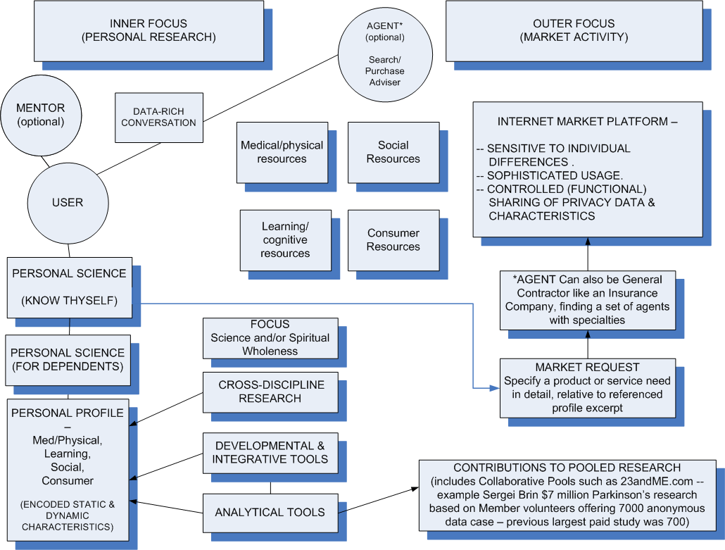
Personal Science Workstation Conceptual Components

Slide 23
Implications for
Researchers, Agents, Guardians
Research Collectives
  Sergei Brin example -- $7 million grant, 7000 subjects – Parkinson’s Disease
Agents to assist finding potential sellers
  Fast-growing job potential (retrain allied field)
Guardian relationships (for children, elderly parents)
  Social dimension of self-knowledge

Slide 24
Some Early Signs -- Emerging
Ingredients of Personal Science
Bill Buxton (Microsoft) -- Three-Mirror Model for the Designer of General User Skills and Senses (1986) – Product design should be a mirror of the user
Pew Charitable Trust – “More Using Electronics To Track Their Health” (Rise of Personal Technology Health Databases) (2013)
23andME.com – DNA capture and peer discussion (2005)
Doc Searl – Wall St Journal - “The Consumer Is a God” – “IntentCast” broadcasting of purchase needs on an Internet Platform (2012)
IBM Ad: “Welcome To the Era of the Chief Executive Customer” -- Their Analytic Marketing Technology Treats People as Unique Individuals, Not Market Segments (2013)
IBM, etc: The Customer’s Information-Access Tools are functionally as powerful, in terms of available knowledge, as the Supplier’s. This is information parity – about the supplier, customer, and content.

